Slide 1

Delhi
Air Quality Prediction
Data-Driven Insights
Prepared by Lipsita Tripathy
January 2024

Slide 2

About Me
Lipsita
Tripathy
Former QA Analyst Transitioning to Data Scientist
With a background in
🎓Electronics and Instrumentation Engineering
📊 Passionate about translating data
into actionable insights
🌐 Striving to contribute to a cleaner, healthier future

Slide 3

Problem Statement ?
By predicting next-day air quality, how can we empower decision-makers with actionable insights to implement timely measures and safeguard urban environments effectively?
Proposed Solution
Implementing a data-driven model to accurately predict next-day air quality index empowering informed decision-making for a healthier environment.

Slide 4
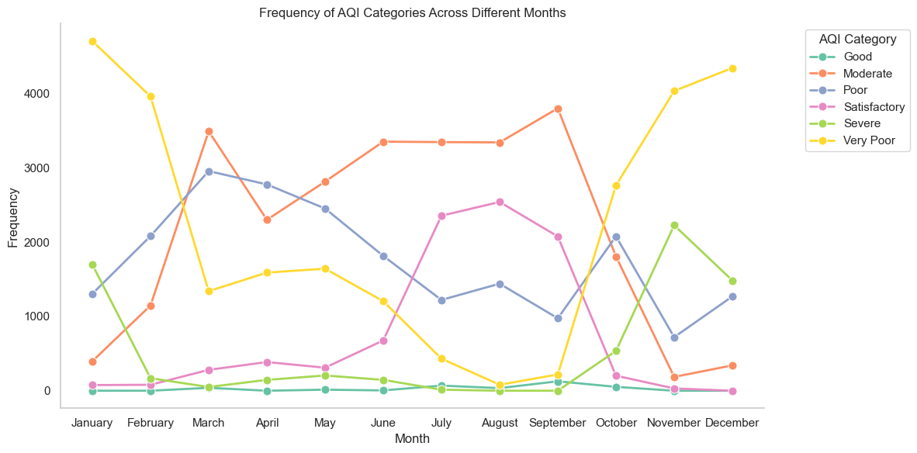
Unveiling Air Quality Trends

Slide 5
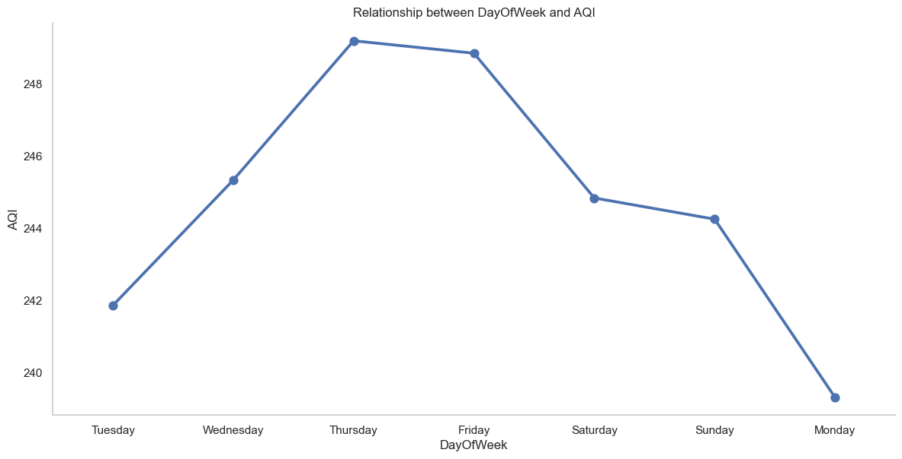
Weekly Rhythms

Slide 6
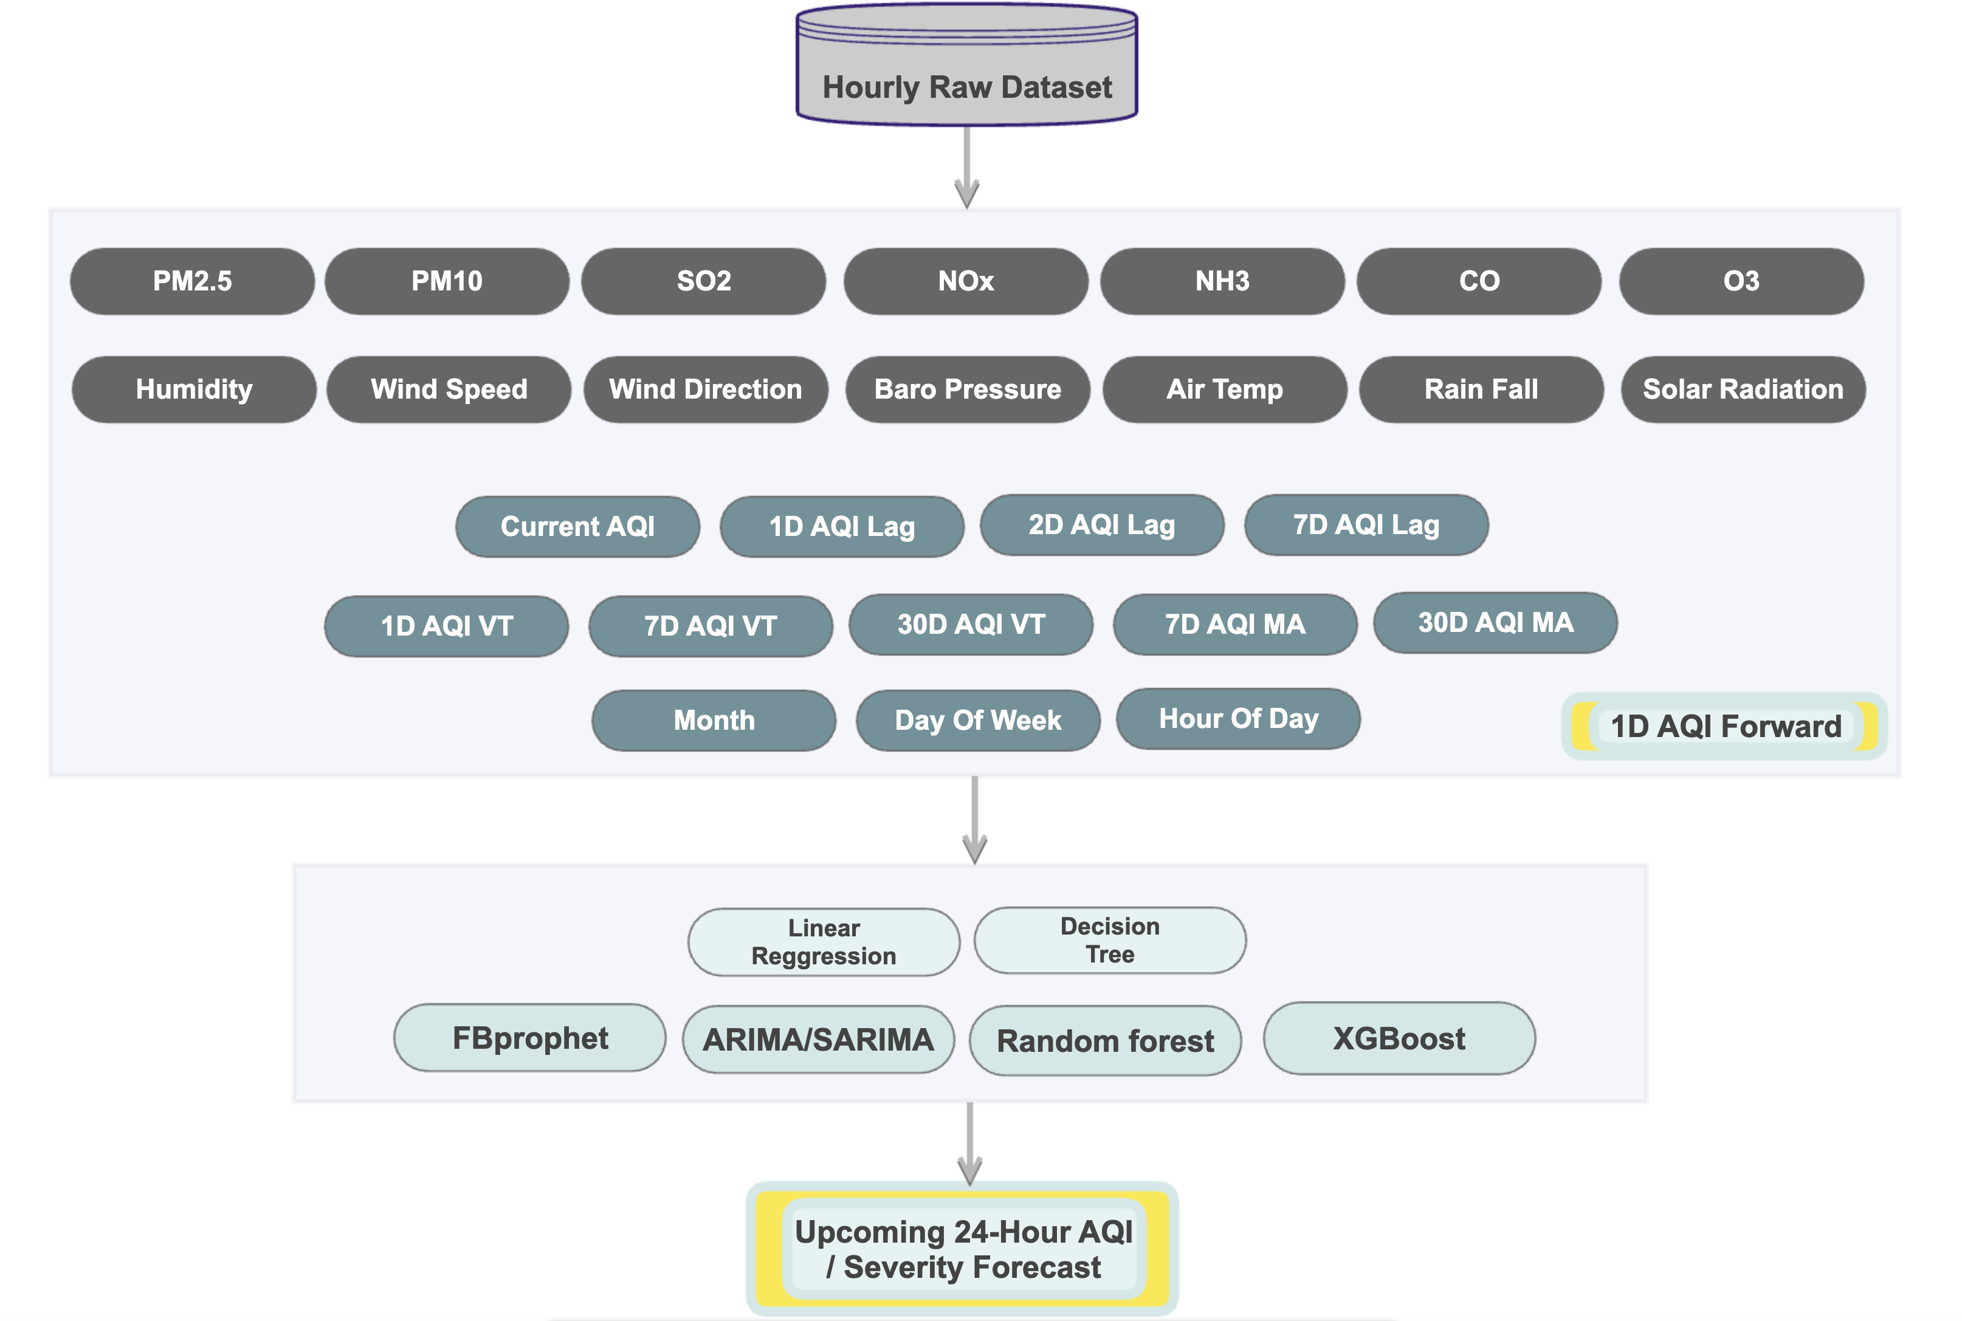
Data
(Kaggle link)

Slide 7
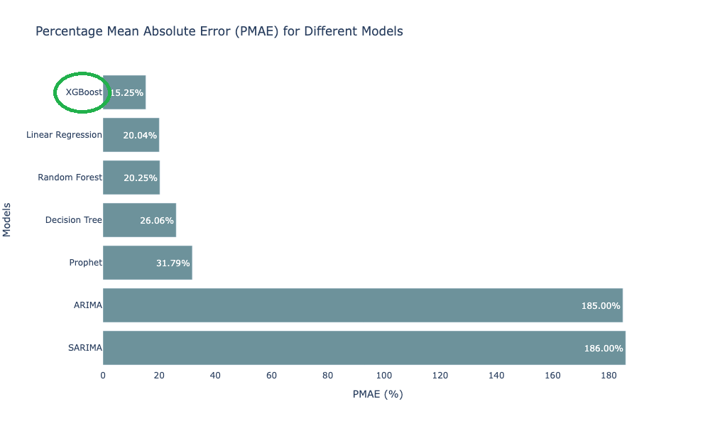
Model Comparision on PMAE

Slide 8
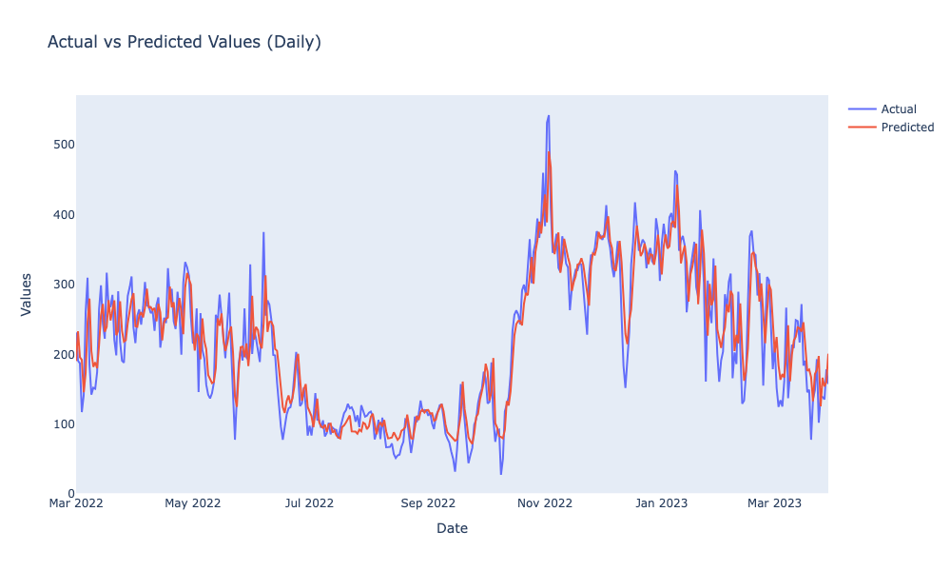
Actual Vs. Predicted AQI

Slide 9
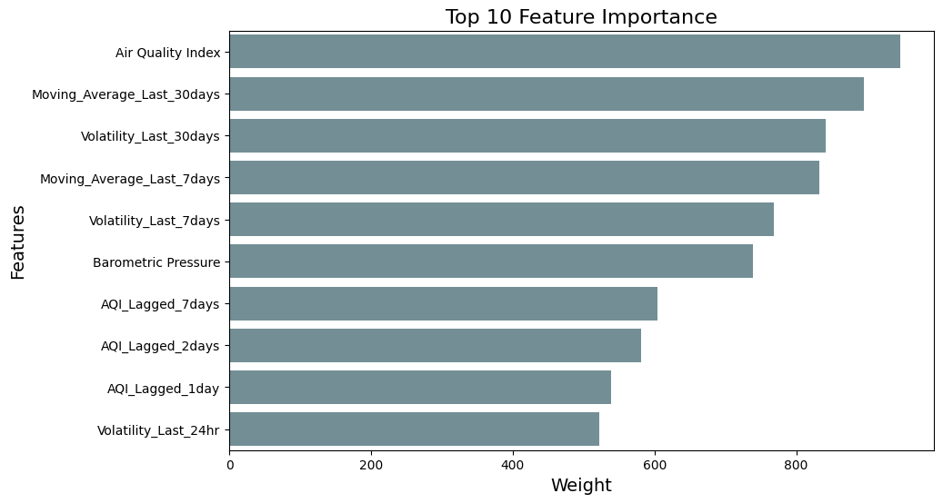
Feature Importance

Slide 10

Product Demo

Slide 11
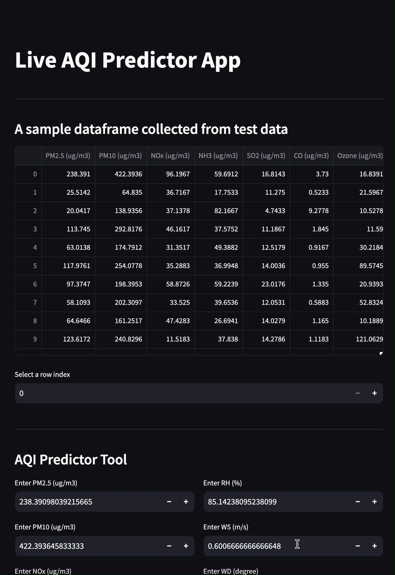

Slide 12

Forging Ahead
Treat Individual Station's Data Independently
Build Location Dependencies
Predict AQI Differences
Extend Prediction Horizon
Explore Advanced Models

Slide 13





🙏 Thank You... Let's Connect!
linkedin.com/in/lipsitatripathy
github.com/lipsitalt/AirQualityPredictor
lipsitalt@gmail.com

